Slide 1
Text Adventure Game
Castle Dungeons
Department of Computer Science
Galgotias College of Engineering and Technology Greater Noida
(Supervisor: Mr. Mayank Dixit & Mr. T. Akilan )
Group Members
Name of Member | Roll Number | Role
Akshay Srivastava | 1809710012 | Complete Development and Documentation

Slide 2

Index
Introduction(scope of the work and its importance)
Hardware /Software Requirement
Design/Implementation
Testing/Result and Analysis
Conclusions & future enhancements
References

Slide 3
Text Adventure Game
Castle Dungeons
An Interactive story game
By Akshay Srivastava

Slide 4
Introduction
Storyline of the game.
The meta-plot begins with the
anticipation stage , in which the hero is called to the adventure to come. This is followed by a dream stage , in which the adventure begins, the hero has some success, and has an illusion of invincibility. However, this is then followed by a frustration stage , in which the hero has his ﬁrst confrontation with the enemy, and the illusion of invincibility is lost. This worsens in the nightmare stage , which is the climax of the plot, where hope is apparently lost. Finally, in the resolution ,the hero overcomes the burden against his odds.

Slide 5
Hardware /Software Requirements
Modern Operating System:
Windows 7 or 10
Mac OS X 10.11 or higher, 64-bit
Linux: RHEL 6/7, 64-bit (almost all libraries also work in Ubuntu)
x86 64-bit CPU (Intel / AMD architecture)
4 GB RAM
5 GB free disk space

Slide 6
Design/Implementation

Slide 7
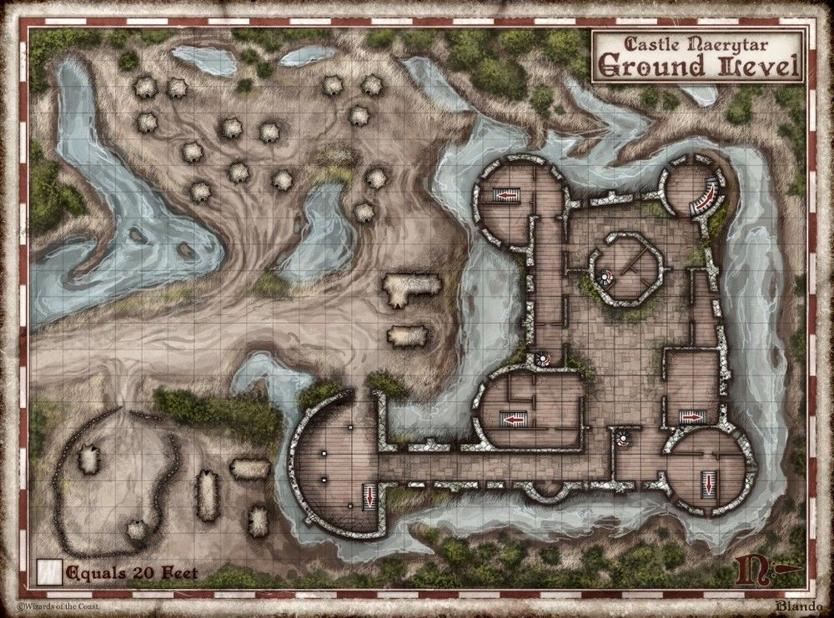
The fantasy map of Castle Dungeons.

Slide 8
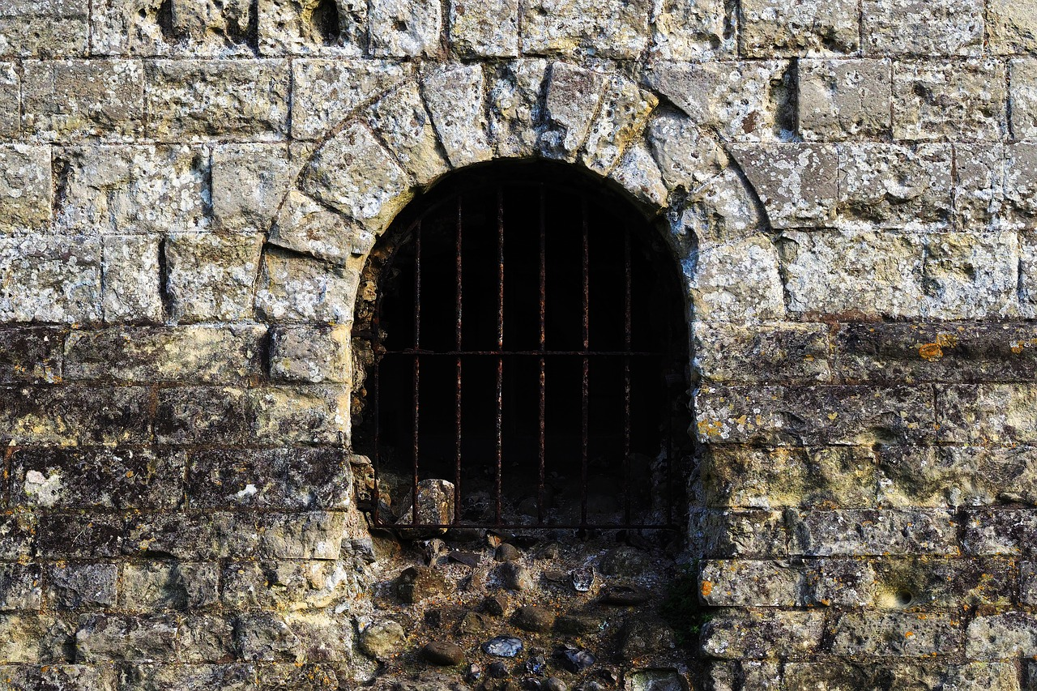
Your Friends are Inside the Dungeon .

Slide 9
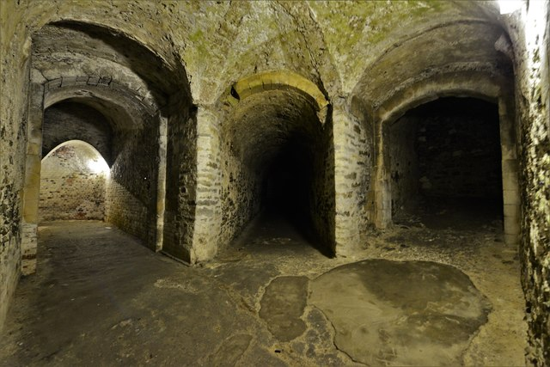
Left or Right?

Slide 10
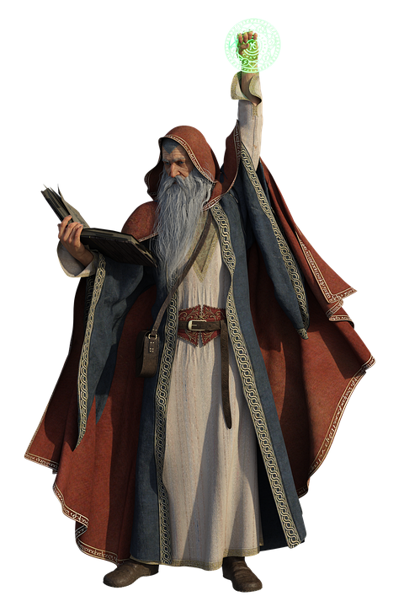
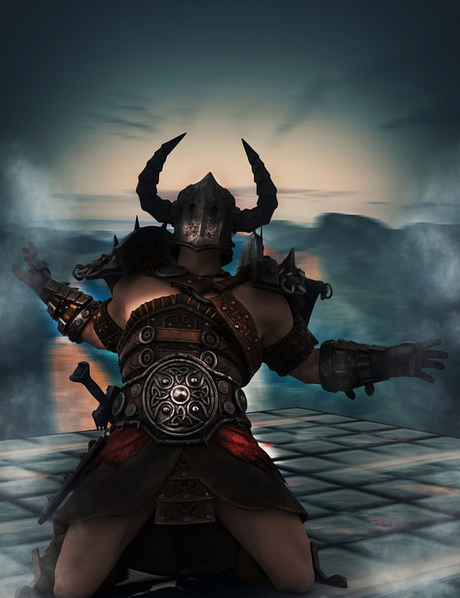
Choose your character class?
1. 2.

Slide 11
Character skill sheet.
1.Character class.
2.Character name.
3.Character race.
4.Character dexterity.
5.Character special powers.
6.Character Strength.
7.Character Life.

Slide 12
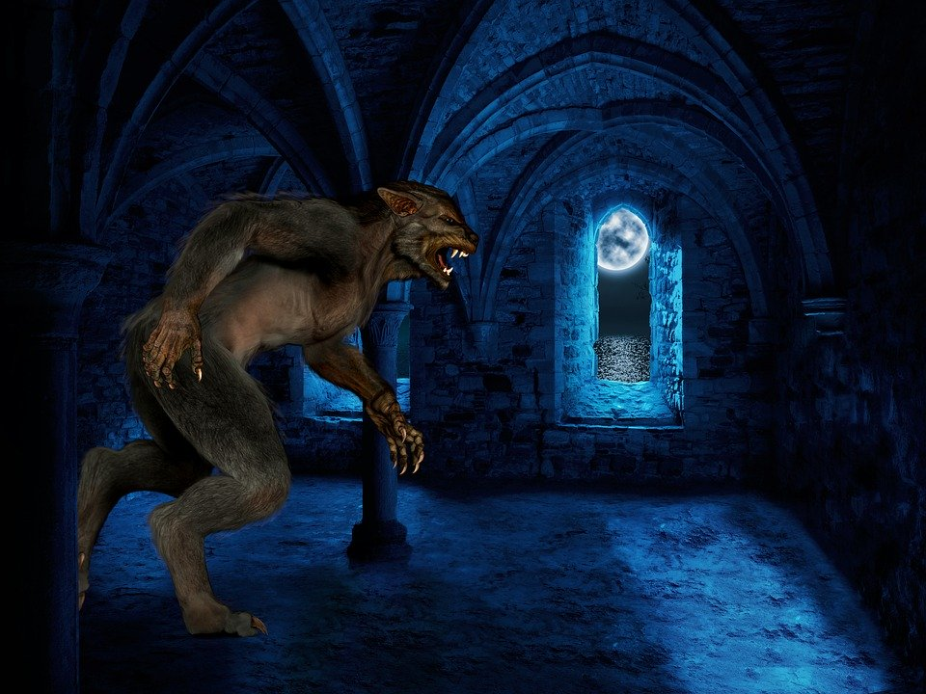
Combat with enemy.

Slide 13
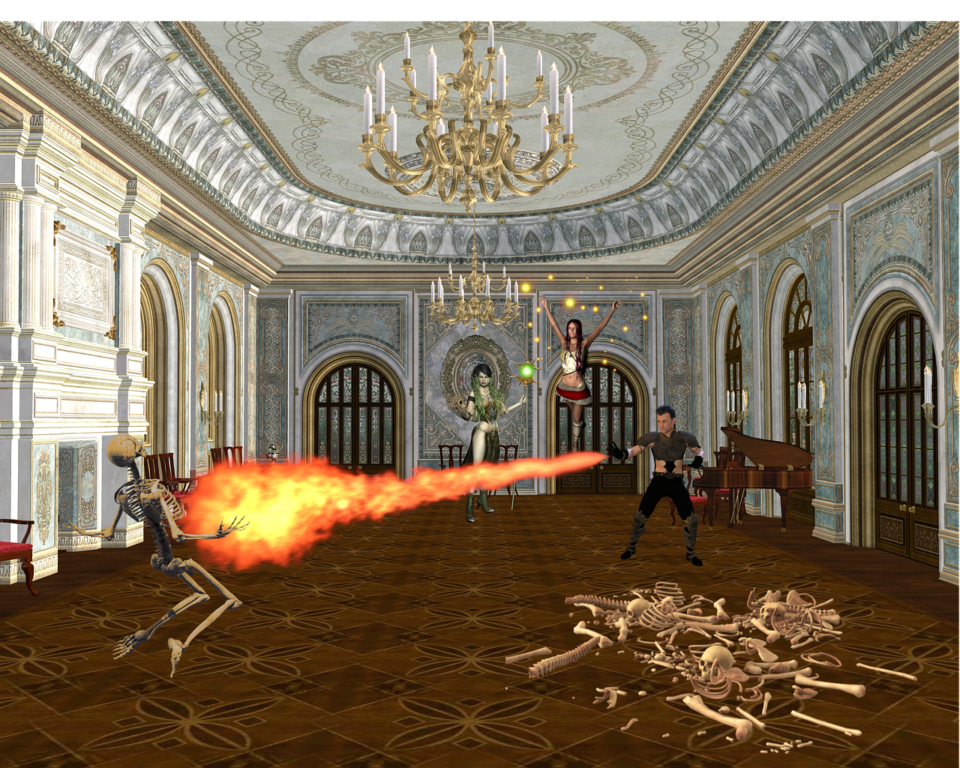
Congratulations!
You defeated the
enemy.

Slide 14

Your Friends are Free!

Slide 15
Conclusion & Future Enhancements
Python and Pygame is a good language and framework for rapid game prototyping or for beginners learning how to make simple games. Ultimately the performance of Python isn't good enough for the performance intensive parts of the game engine for higher end games. Your export options may be limited to devices with a python interpreter however, which basically excludes mobile.
Python is also good for building tools for game designers which simplify tasks like level design or dialog tree creation and having those tools export that work into a format the main game engine can use.

Slide 16
References
https://www.python.org/
https://wiki.python.org/moin/GameProgramming

Slide 17
Thank You

